Slide 1
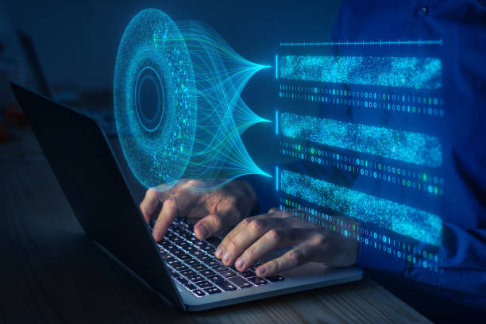
Course Title: Computer Vision And Image Processing
Course Code: CSE-4117

Slide 2
Computer Vision And Image Processing
Computer Vision focuses on enabling machines to interpret and analyze visual data.
Example Tasks: Object detection, face recognition, autonomous vehicle navigation.
Image Processing involves techniques to enhance, transform, and extract information from images.
Example Tasks: Noise removal, contrast enhancement, image resizing.

Slide 3
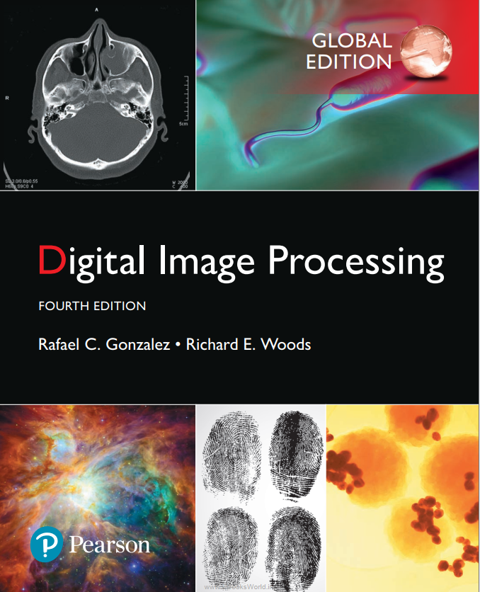
Reference Books
:
Download Here!!!! https://dl.icdst.org/pdfs/files4/01c56e081202b62bd7d3b4f8545775fb.pdf

Slide 4
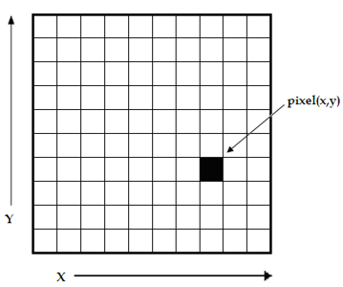
Introduction: Image Processing
Definition: An IMAGE may be defined as a two-dimensional function, f (x, y), where x and y are spatial (plane) coordinates, and the amplitude of f at any pair of coordinates (x,y ) is called the intensity or gray level of the image at that point.
When x, y, and the intensity values of f are all finite, discrete quantities, we call the image a digital image.
A digital image consists of finite elements called pixels (short for picture elements), each with a specific location and value.
Pixels are the most commonly used term to represent the basic units of a digital image.
Intensity5

Slide 5

Introduction: Image Processing
There are no clear-cut boundaries in the continuum from image processing at one end to computer vision at the other.
image processing
computer vision
3 types of Computerized Processes:
Low-Level Processing: Involves operations like noise reduction, contrast enhancement, and image sharpening, where both input and output are images.
Mid-Level Processing: Includes segmentation, object description, and classification, where inputs are images, and outputs are attributes like edges, contours, or object identities.
High-Level Processing: Focuses on making sense of recognized objects, such as analyzing relationships or performing cognitive tasks.

Slide 6
Introduction: Image Processing
Early Application:
Digital images were first used in the 1920s in the newspaper industry for transmitting pictures via submarine cable between London and New York.
The Bartlane cable picture transmission system reduced transmission time from over a week to less than three hours.
Bartlane System:
Pictures like Figure 1.1 were coded for transmission and reconstructed using a telegraph printer simulating halftone patterns.
Fig:1 (Limited control over
brightness levels)

Slide 7
Introduction: Image Processing
Printing Challenges:
Early methods had issues like uneven brightness and poor resolution.
Toward the end of 1921, a photo-based method using perforated tapes replaced the old system, improving tonal quality and resolution (Figure 1.2).
Gray Levels:
Initially, the Bartlane system could represent images in 5 gray levels.
By 1929, it expanded to 15 levels, producing better images like Figure 1.3.
Fig:1.2
Fig:1.3

Slide 8
Introduction: Image Processing
Advancements:
A new system using light beams modulated by coded tapes greatly improved the reproduction process.
Limitations:
These methods were not true digital image processing since they did not use digital computers.
The development of digital image processing is closely tied to advances in digital computers, storage, display, and transmission technologies.

Slide 9
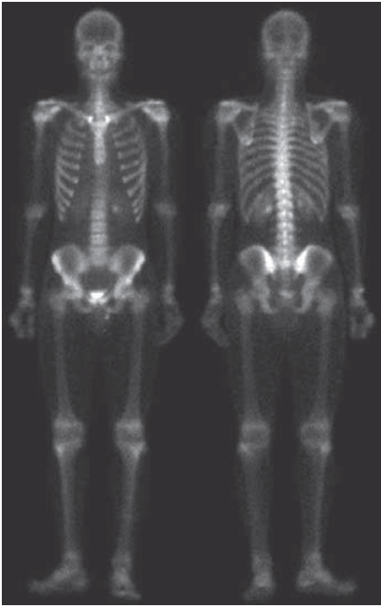
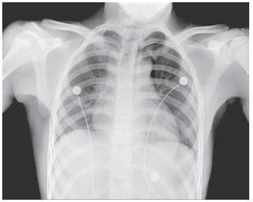
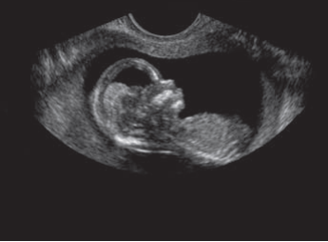
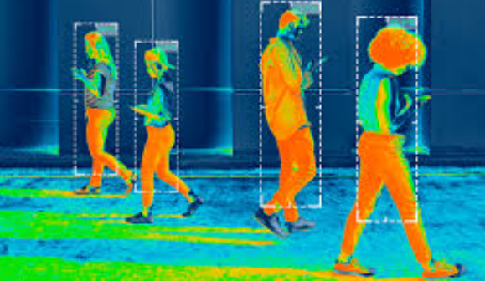
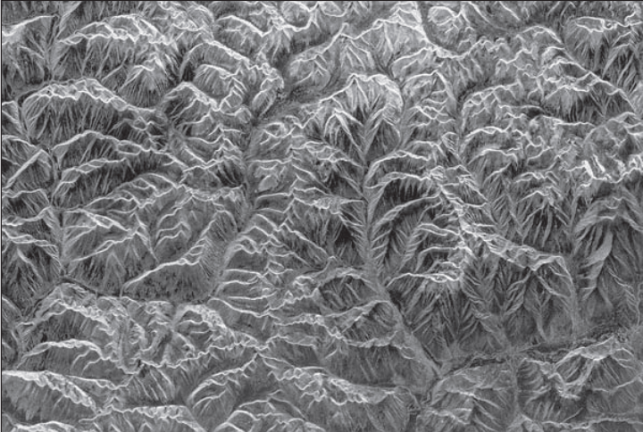
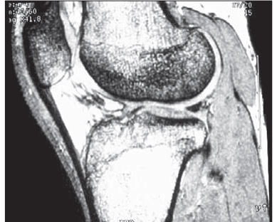
Image Processing: Image Type
Region | Imaging Type | Definition and Applications | Image
Gamma Rays | Gamma-Ray Imaging | High-energy imaging used in nuclear medicine (e.g., PET scans) and astrophysics to detect radioactive materials or celestial phenomena.
X-rays | X-Ray Imaging | Penetrates soft tissues but not dense materials like bones; widely used in medical diagnostics and security screenings.
Ultraviolet | UV Imaging | Captures details invisible to the human eye; used for detecting skin conditions, forensic investigations, and astronomy.
Visible Light | Optical Imaging | Standard imaging detected by human eyes and cameras; used in photography, microscopy, and daily visual perception.
Infrared | Infrared Imaging | Captures heat emitted by objects; used in thermal cameras for surveillance, energy audits, and medical diagnostics.
Microwaves | Microwave Imaging | Penetrates fog and clouds; used in radar systems, weather prediction, and breast cancer detection technologies.
Radio Waves | Radio Imaging | Captures signals from celestial objects and Earth; used in radio telescopes for astronomy and ground-penetrating radar for subsurface imaging.

Slide 10
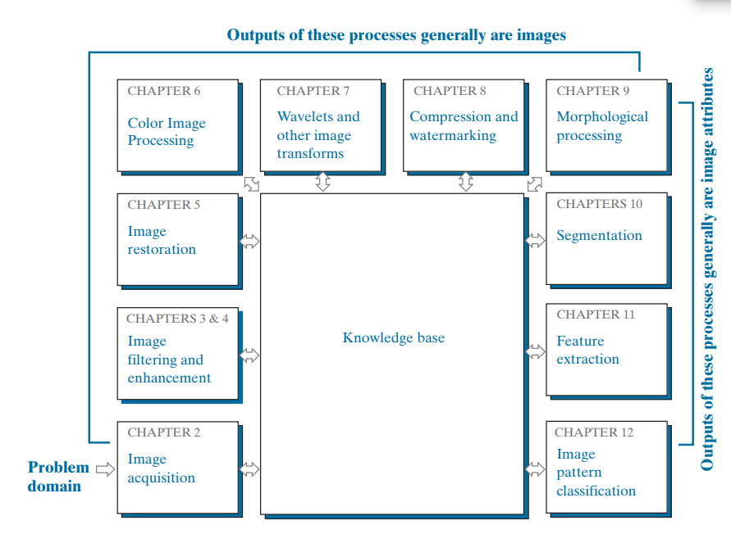
Introduction: Steps in digital image processing
Figure 1.4 : Fundamental steps in digital image processing.

Slide 11
steps in digital image processing
1. Image acquisition: is the first process in Fig 1.4. provide some hints regarding the origin of digital images.
2. Image enhancement: is the process of manipulating an image so the result is more suitable than the original for a specific application.
3. Image restoration improves an image by using mathematical or probabilistic models to address degradation, making it an objective process. In contrast, image enhancement is subjective, focusing on human preferences for what looks better.
4. Color image processing is essential due to the widespread use of digital images online and in applications like photography, medical imaging, and remote sensing.

Slide 12
Image Filtering /Enhancement
5. Wavelets are a method used to analyze and process images at different levels of detail. This means they allow an image to be broken down into simpler, smaller parts that show less or more detail depending on the level.
6. Compression, as the name implies, deals with techniques for reducing the storage
required to save an image, or the bandwidth required to transmit it.
7. Morphological processing focuses on extracting important components of an image that help describe its shape. This chapter shifts from image generation to analyzing and describing image features.

Slide 13
Image Filtering /Enhancement
8 . Segmentation partitions an image into its constituent parts or objects.
6. Feature Extraction, almost always follows the output of a segmentation stage, which usually is raw pixel data, constituting either the boundary of a region (i.e., the set of pixels separating one image region from another) or all the points in the region itself.
7. Image pattern classification is the process that assigns a label (e.g., “vehicle”) to an object based on its feature descriptors.

Slide 14
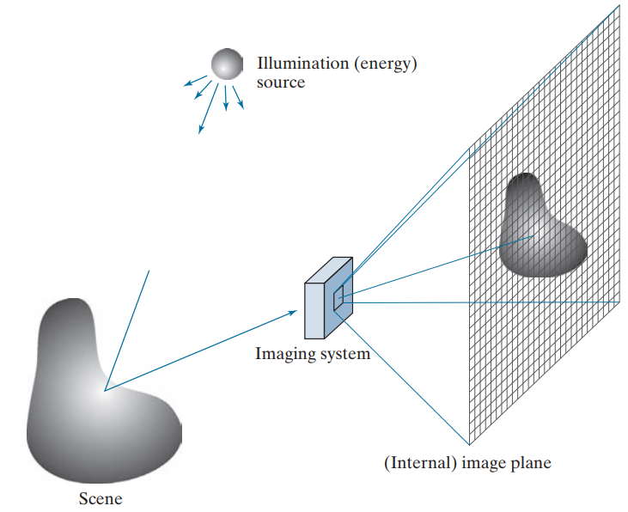
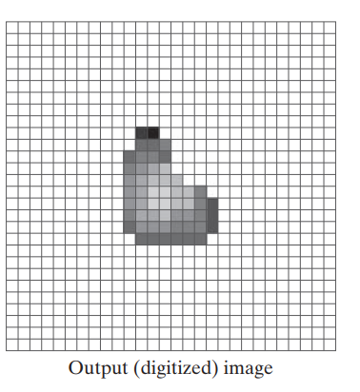
Acquire Digital Image
(a)
(b)
. (c)
(e)
(d)
(a) Illumination (energy) source. (b) A scene. (c) Imaging system.
(d) Projection of the scene onto the image plane. (e) Digitized image.

Slide 15
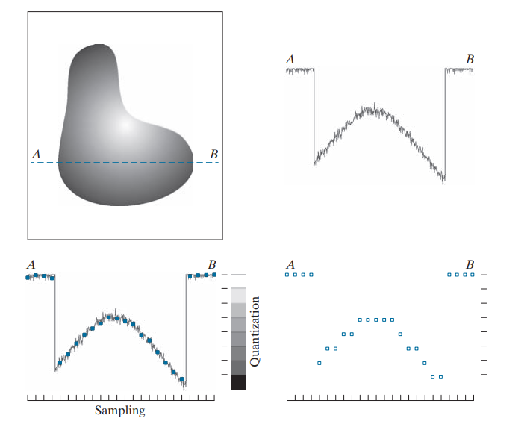
Acquire Digital Image
Digitizing the coordinate values is called sampling
Digitizing the amplitude values is called quantization.
(a)
(b)
. (c)
(d)
(a) Continuous image. (b) A scan line showing intensity variations along line AB in the continuous
image. (c) Sampling and quantization. d) Digital scan line. (The black border in (a) is included for
clarity. It is not part of the image).

Slide 16
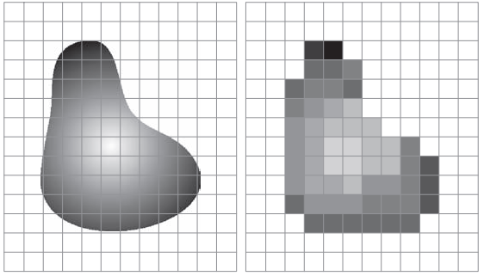
Acquire Digital Image
(a)
(b)
(a) Continuous image projected onto a sensor array. (b) Result of image sampling and quantization.

Slide 17
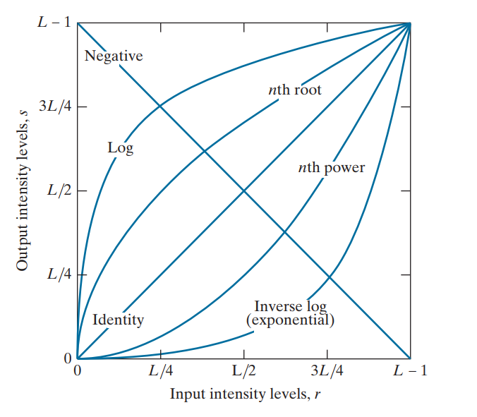
Intensity Transformation
Figure: Some basic intensity transformation functions.

Slide 18
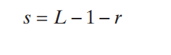
Enhancement: Intensity Transformation
254
Negative
0
255
0

Slide 19
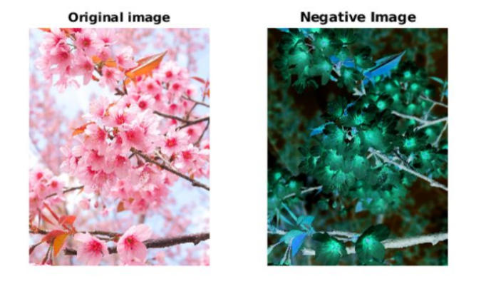
Introduction: Image Processing
1. IMAGE NEGATIVES:

Slide 20
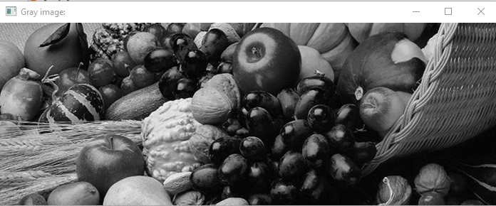
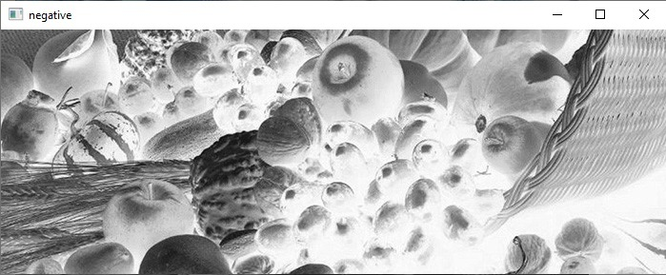
Introduction: Image Processing
1. IMAGE NEGATIVES:

Slide 21
Introduction: Image Processing
2. LOG TRANSFORMATIONS:
Log Transformation: Makes dark areas brighter and compresses bright areas.
Purpose: Helps show details in dark parts of an image.
Inverse Log Transformation: Does the opposite—makes bright areas brighter and compresses dark areas.
Use: Adjust image brightness to focus on specific details.

Slide 22
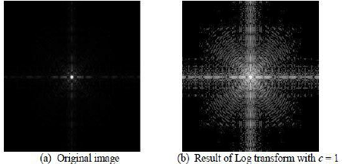
Introduction: Image Processing
2. LOG TRANSFORMATIONS:

Slide 23
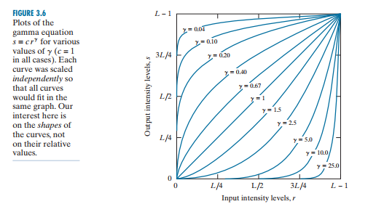
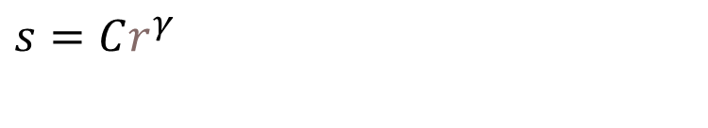
Introduction: Image Processing
3. POWER-LAW (GAMMA) TRANSFORMATIONs
$s=Cr^{γ}$

Slide 24
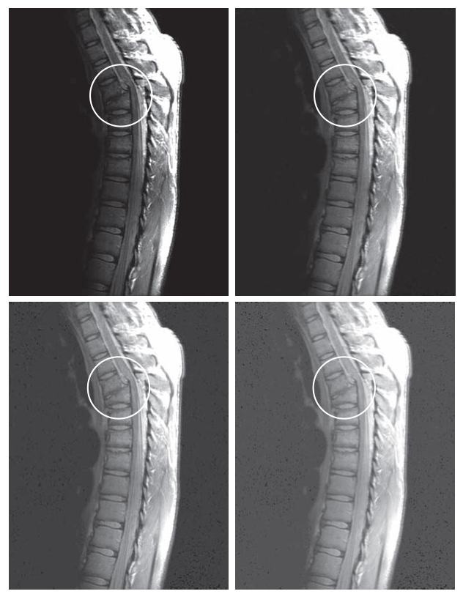

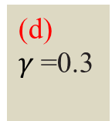
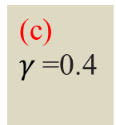
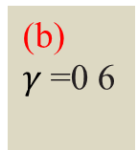
Introduction: Image Processing
3. POWER-LAW (GAMMA) TRANSFORMATIONs $s=Cr^{γ}$
(a)
(MRI) human spine
(b)
$γ$=0 6
(d)
$γ$=0.3
(c)
$γ$=0.4

Slide 25
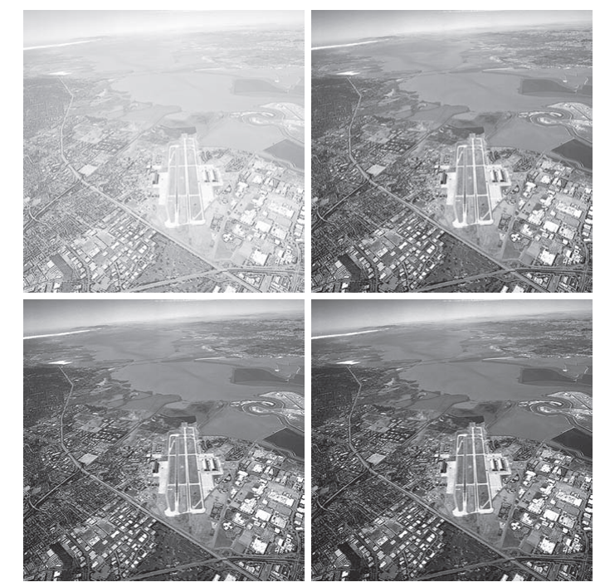




Introduction: Image Processing
3. POWER-LAW (GAMMA) TRANSFORMATIONs $s=Cr^{γ}$
(a) Aerial image.
(b) $γ$=3.0
(c)$γ$=4.0
(d) $γ$=5.0

Slide 26
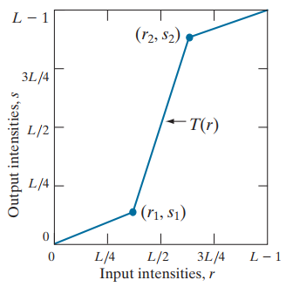

PIECEWISE LINEAR TRANSFORMATION
4. PIECEWISE LINEAR TRANSFORMATION FUNCTIONS: is a type of image intensity transformation that applies different linear mappings to specific intensity ranges in an image. It is useful for enhancing certain features or adjusting the overall intensity distribution.

Slide 27
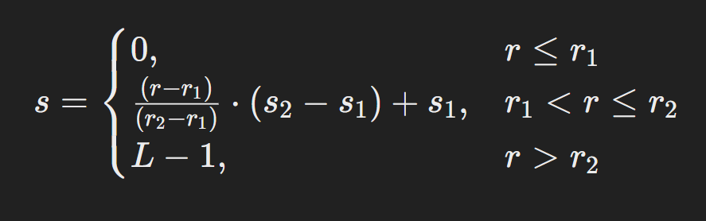
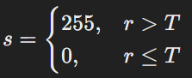
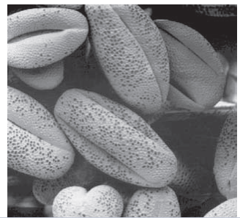
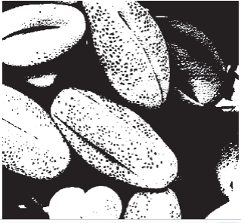
PIECEWISE LINEAR TRANSFORMATION
Piecewise linear
transformation function.
(b) A lowcontrast electron
microscope image of pollen
c)Result of contrast stretching
d) Result of thresholding

Slide 28
5 | 1 | 6
3 | 2 | 4
5 | 3 | 5

Slide 29
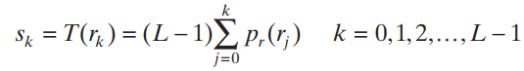
Histogram Equalization
Histogram Equalization is a technique used to enhance the contrast of an image by spreading out the most frequent intensity values.
It works by transforming the intensity values of an image so that the histogram of the output image is approximately uniform.

Slide 30
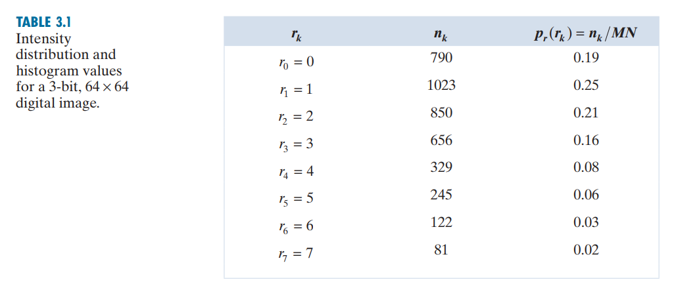
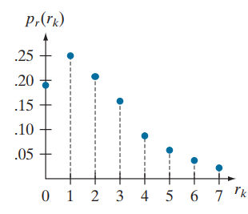

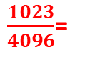
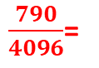
Histogram Equalization
$\frac{790}{4096}$=
$\frac{1023}{4096}$=
4096

Slide 31
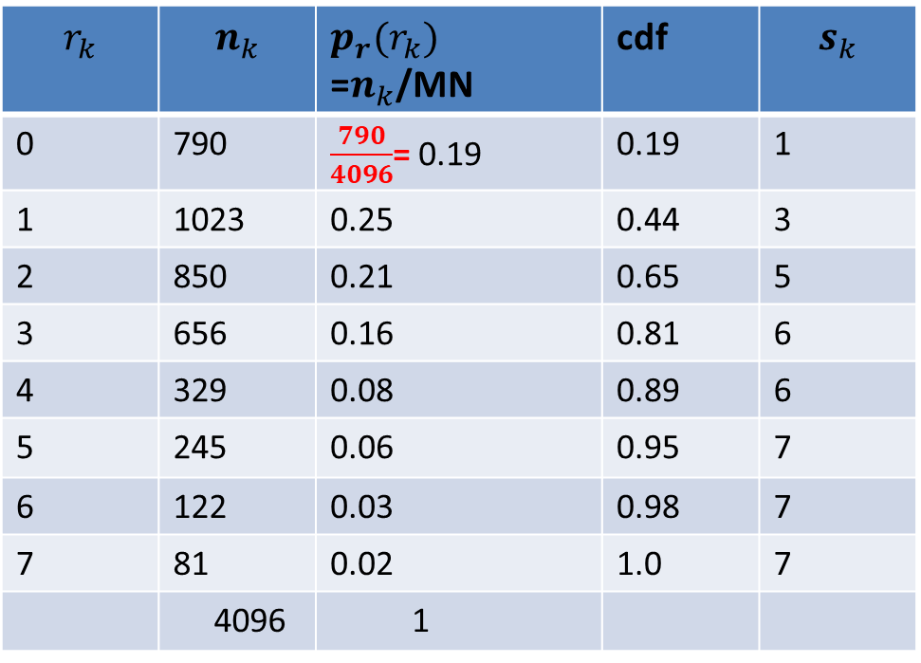
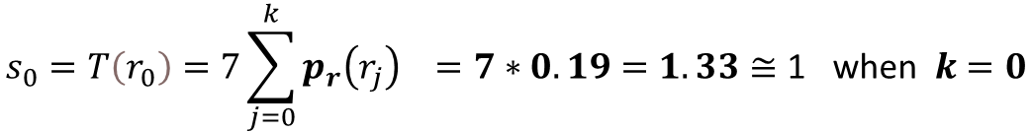
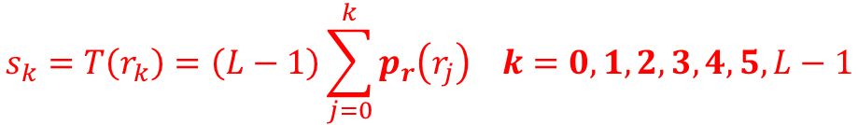
Histogram Equalization
Table: Intensity distribution
of 3 Bits (L=8) 64X64 Image
$$r_{k}$$ | $$n_{k}$$ | $p_{r}(r_{k})$ =$n_{k}$/MN | cdf | $$s_{k}$$
0 | 790 | $\frac{790}{4096}$= 0.19 | 0.19 | 1
1 | 1023 | 0.25 | 0.44 | 3
2 | 850 | 0.21 | 0.65 | 5
3 | 656 | 0.16 | 0.81 | 6
4 | 329 | 0.08 | 0.89 | 6
5 | 245 | 0.06 | 0.95 | 7
6 | 122 | 0.03 | 0.98 | 7
7 | 81 | 0.02 | 1.0 | 7
 | 4096 | 1
$$s_{k}=T\left(r_{k}\right)=\left(L−1\right)\sum_{j=0}^{k}{p_{r}\left(r_{j}\right) k=0,1,2,3,4,5, L−1}$$
$$s_{0}=T\left(r_{0}\right)=7\sum_{j=0}^{k}{p_{r}\left(r_{j}\right) =7∗0.19=1.33≅\text{1 } \text{when} k=0}$$
Similarly,
$s_{1}=T\left(1\right)$=7*(0.19+0.25)=7*0.44=3.08 $≅\text{3} \text{when} k=1$
$s_{2}=4.55$, $s_{3}=5.67$ $s_{4}=6.23$, $s_{5}=6.65$ $s_{6}=6.86$, $s_{7}=7.00$

Slide 32
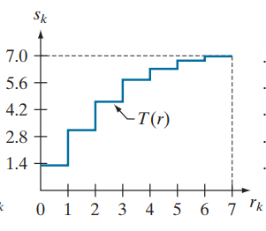
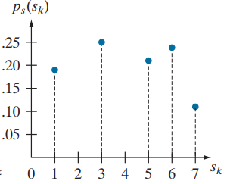
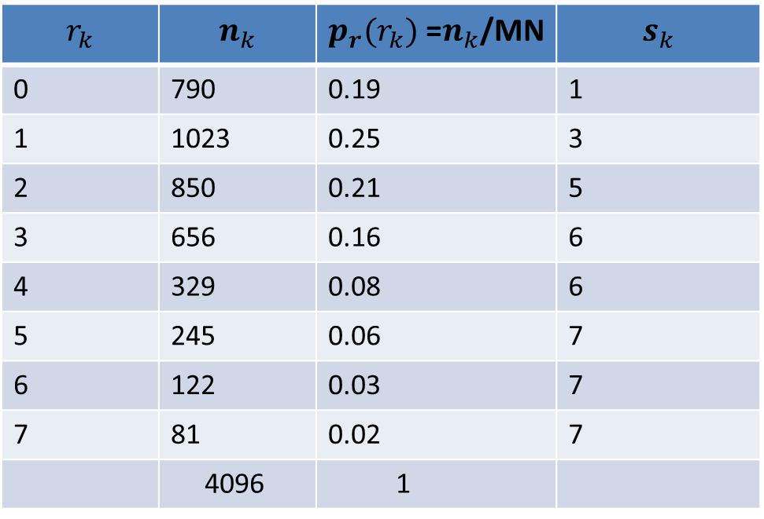
Histogram Equalization
$$r_{k}$$ | $$n_{k}$$ | $p_{r}(r_{k})$ =$n_{k}$/MN | $$s_{k}$$
0 | 790 | 0.19 | 1
1 | 1023 | 0.25 | 3
2 | 850 | 0.21 | 5
3 | 656 | 0.16 | 6
4 | 329 | 0.08 | 6
5 | 245 | 0.06 | 7
6 | 122 | 0.03 | 7
7 | 81 | 0.02 | 7
 | 4096 | 1
After HE
Before HE

Slide 33
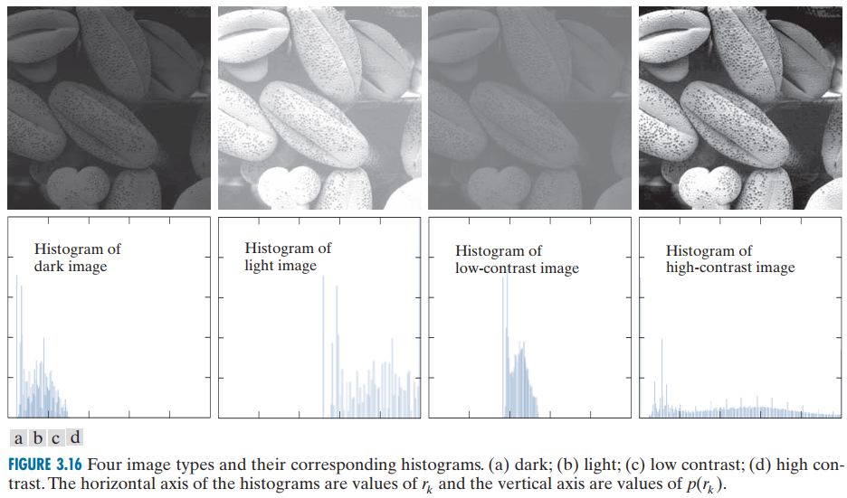
Histogram Equalization
a) Dark
b) light
c) Low contrast
d)High contrast

Slide 34
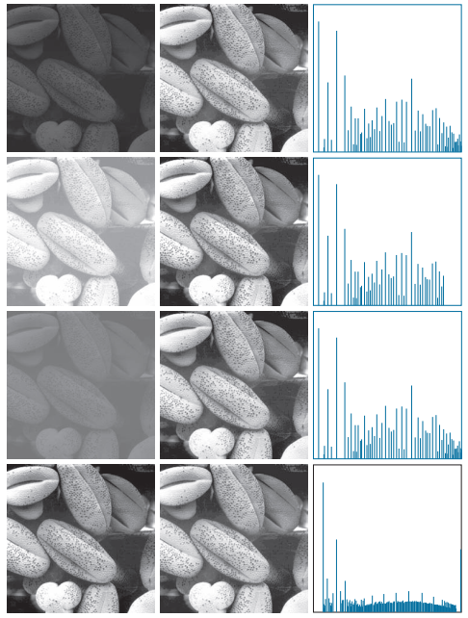
Histogram Equalization
images
HE Image
Histogram

Slide 35
Histogram Equalization
Exercise: Apply HE on the following 3 Bits (L=8) 5X5 image
0 | 0 | 1 | 1 | 2
3 | 3 | 4 | 2 | 3
4 | 4 | 0 | 0 | 3
3 | 3 | 3 | 0 | 2
4 | 4 | 4 | 1 | 1

Slide 36
Histogram Equalization
Step | Action | Formula/Equation | Explanation
1 | Compute the histogram of the image | P(rk) | Calculate the frequency of each pixel intensity in the image.
2 | Compute the CDF of the histogram | CDF(rk) = sum(P(rk)) | Calculate the cumulative sum of histogram values for each intensity level.
3 | Normalize the CDF | T(rk) = round((L-1) * CDF(rk)) | Normalize the CDF to the range [0, L-1] to get the new intensity values.
4 | Apply the transformation to the image | T(rk) | Map each pixel’s original value to the new value using the transformation function T(rk).

Slide 37
Histogram Matching/Specification
Intensity | Count | Input PDF (P(i)) | Input CDF (F(i))
0 | 500 | 500 / 4096 = 0.1221 | 0.1221
1 | 800 | 800 / 4096 = 0.1953 | 0.3174
2 | 1000 | 1000 / 4096 = 0.2441 | 0.5615
3 | 900 | 900 / 4096 = 0.2197 | 0.7812
4 | 600 | 600 / 4096 = 0.1465 | 0.9277
5 | 200 | 200 / 4096 = 0.0488 | 0.9766
6 | 80 | 80 / 4096 = 0.0195 | 0.9961
7 | 16 | 16 / 4096 = 0.0039 | 1.0000
Input Histogram

Slide 38
Histogram Matching/Specification
Intensity | Count | Target PDF (P(j)) | Target CDF (G(j))
0 | 512 | 512 / 4096 = 0.1250 | 0.1250
1 | 512 | 512 / 4096 = 0.1250 | 0.2500
2 | 512 | 512 / 4096 = 0.1250 | 0.3750
3 | 512 | 512 / 4096 = 0.1250 | 0.5000
4 | 512 | 512 / 4096 = 0.1250 | 0.6250
5 | 512 | 512 / 4096 = 0.1250 | 0.7500
6 | 512 | 512 / 4096 = 0.1250 | 0.8750
7 | 512 | 512 / 4096 = 0.1250 | 1.0000
Target Histogram

Slide 39
Histogram Matching/Specification
Each input intensity is mapped to the target intensity whose target CDF is closest to the input CDF:
Input Intensity (i) | Input CDF (F(i)) | Mapped Target Intensity (j) | Target CDF (G(j))
0 | 0.1221 | 0 | 0.1250
1 | 0.3174 | 2 | 0.3750
2 | 0.5615 | 4 | 0.6250
3 | 0.7812 | 5 | 0.7500
4 | 0.9277 | 6 | 0.8750
5 | 0.9766 | 7 | 1.0000
6 | 0.9961 | 7 | 1.0000
7 | 1.0000 | 7 | 1.0000

Slide 40
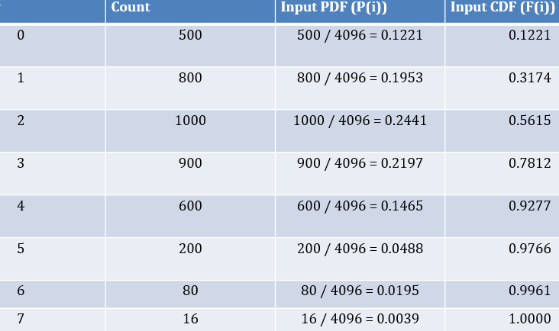
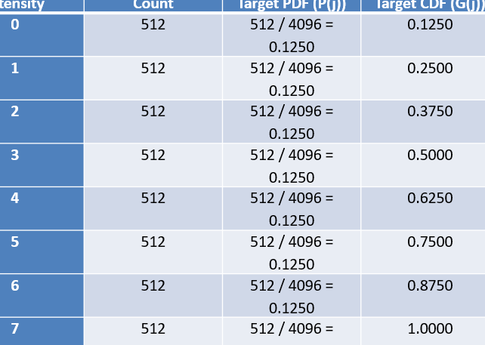
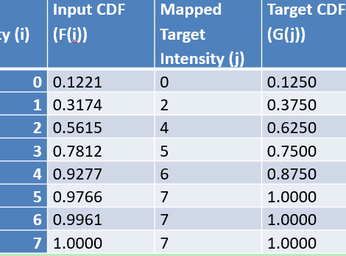
Output
Input
Matching

Slide 41
Histogram Matching/Specification
Applications of Histogram Matching
Histogram matching is commonly used in the following scenarios:
1. **Image Normalization:** To normalize images with varying lighting conditions for better analysis. 2. **Style Transfer:** To make one image visually resemble another (e.g., in art or design). 3. **Preprocessing for Machine Learning:** To standardize input images before training models. 4. **Medical Imaging:** To adjust contrast in CT or MRI scans for better diagnosis.
When to Use Histogram Matching
Histogram matching is particularly useful when you need to: 1. Standardize the intensity distribution across multiple images. 2. Enhance visual similarity between images for visual comparison or analysis. 3. Prepare images for tasks requiring uniform intensity distributions, such as segmentation or feature extraction.

Slide 42

Local Histogram Equalization
objects embedded in the dark squares
Original image
(five black squares on a light gray background.
five black squares on a light gray background with noisy look. )
Global Histogram Equalized image. , this image shows significant enhancement of the noise. Does not reveal any significant details
Local Histogram image. Revealing significant details with noise

Slide 43
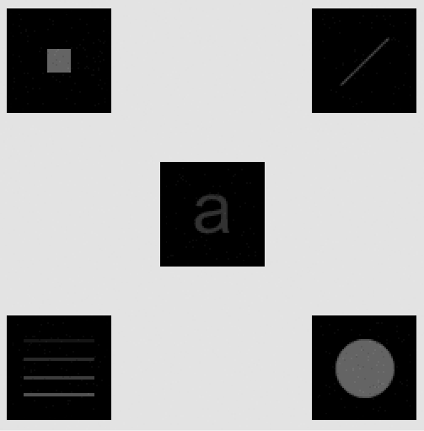
Local enhancement using histogram statistics
Original image
Output image.

Slide 44
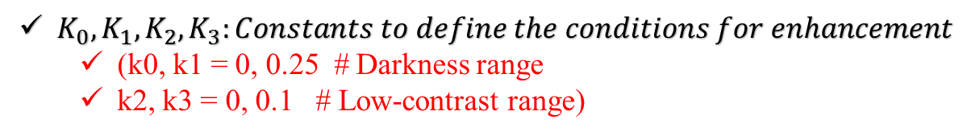

Local enhancement using histogram statistics
Notations
$f\left(x,y\right):is Intensity value of the pixel at location (x,y in the Original Image)$
g$\left(x,y\right):is Intensity value of the pixel at location (x,y in the enhanced Image)$
$m_{G}:Global mean intensity of the entire image$
$m_{s_{xy}}$ :is Local mean intensity in the neighborhood of (x,y)
$σ_{G}$: Global standard deviation of the image
$σ_{s_{xy}}$:Local standard Deviation in the neighborhood of (x,y)
$K_{0},K_{1},K_{2},K_{3}:Constants to define the conditions for enhancement$
(k0, k1 = 0, 0.25 # Darkness range
k2, k3 = 0, 0.1 # Low-contrast range)
C: Enhancement Constant (scaling factor)
Conditions for Enhancement(1. Darkness and 2. Low-Contrast)
1. Darkness Criterion: $k_{0}m_{G}≤m_{s_{xy}}$ $≤k_{0}m_{G}$
(This ensures that the pixel is in a relatively dark area compared to the global mean.)
2.Low-Contrast Criterion: $k_{2}σ_{G}≤σ_{s_{xy}}$ $≤k_{3}σ_{G}$
(This ensures that the pixel is in a low-contrast region.)
If both conditions are satisfied, the pixel intensity is enhanced as follows: g(x,y)=C⋅f(x,y)
If the conditions are not satisfied, the pixel remains unchanged: g(x,y)=f(x,y)

Slide 45



Implementation of Local enhancement using histogram statistics
1.Compute the global mean $m_{G}$​ and global standard deviation $σ_{G}$of the image f(x,y).
2.For each pixel (x,y) of Image f(x,y):
2.1 Compute the local mean, $m_{s_{xy}}$ ​​ and local standard deviation ​​ $σ_{s_{xy}}$within a neighborhood around (x,y).
2.2 Check if the pixel satisfies the darkness and low-contrast criteria.
2.3 If both criteria are met, enhance the pixel intensity using C.
2.4 Otherwise, leave the pixel intensity unchanged.
3. Construct the enhanced image g(x,y).

Slide 46
When to Use Which
Processing Method | When to Use
Negative Transformation | To invert pixel values, useful for analyzing images like X-rays or negatives.
Log Transformation | To enhance dark areas and reduce brightness in very bright regions.
Gamma Correction | To adjust overall brightness or contrast, useful for correcting underexposed or overexposed images.
Contrast Stretching | To improve the overall contrast of an image with low contrast.
Histogram Equalization | To enhance the global contrast, especially in images with uneven brightness distribution.
Bit Plane Slicing | To analyze individual bits of pixel values, useful in image compression or watermarking.
Global Thresholding | To separate objects from the background when the intensity difference is clear.
Adaptive Thresholding | To separate objects from the background when lighting conditions vary across the image.

Slide 47

Introduction: Image Processing
Key Application Areas:
Enhancement: Improving images for human interpretation.
Analysis: Processing images for tasks like storage, transmission, and information extraction.

